Slide 1
PREHISTORY OF CHINA
THE ARCHAEOLOGICAL PAST

Slide 2
Major Trends (earliest times-8th century BCE)
From villages to walled city states
From patriarchal to patrimonial political control
From medium of the spirit world to the “Son of Heaven”

Slide 3
Significant Periods (from Legend to History)
Neolithic Revolution (10,000-4000 BCE): the period in which groups of hunter-gathers worldwide became food producers.
XIA DYNASTY (夏) (ca. 2100-1600 BCE): the legendary first dynasty of China.
SHANG DYNASTY (商) (ca. 1600-1122 BCE): the first Chinese dynastic order found in the archaeological record.
Note: dates before 841 BCE are all legendary!

Slide 4
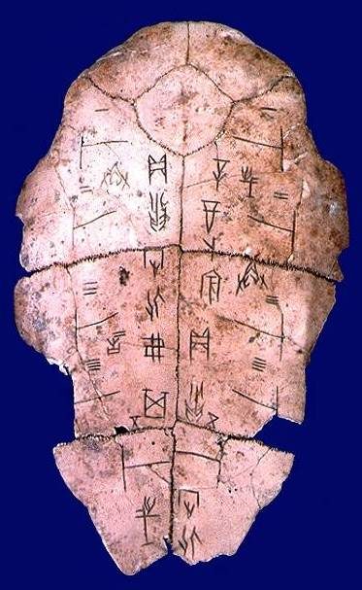
Oracle bones (jiaguwen甲骨文)
Tortoise shells and cow scapulae used in ancient practices of divination. These bones include earliest examples of Chinese writing, dating to the late Shang period (ca. 1200 BCE)
Image source:academic.brooklyn.cuny.edu/core9/phalsall

Slide 5
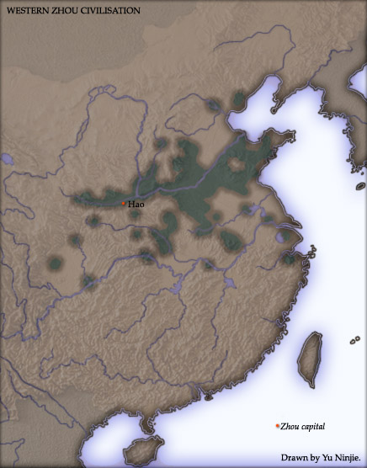
THE ZHOU DYNASTY(周) ca. 1122–256 BCE
Emergence of central ruling house & system of Chinese feudalism.
New political institutions to curb the ruler’s limitless authority.
Defining the interior and exterior of Chinese “civilization.”
The long, violent birth of the Chinese empire.

Slide 6
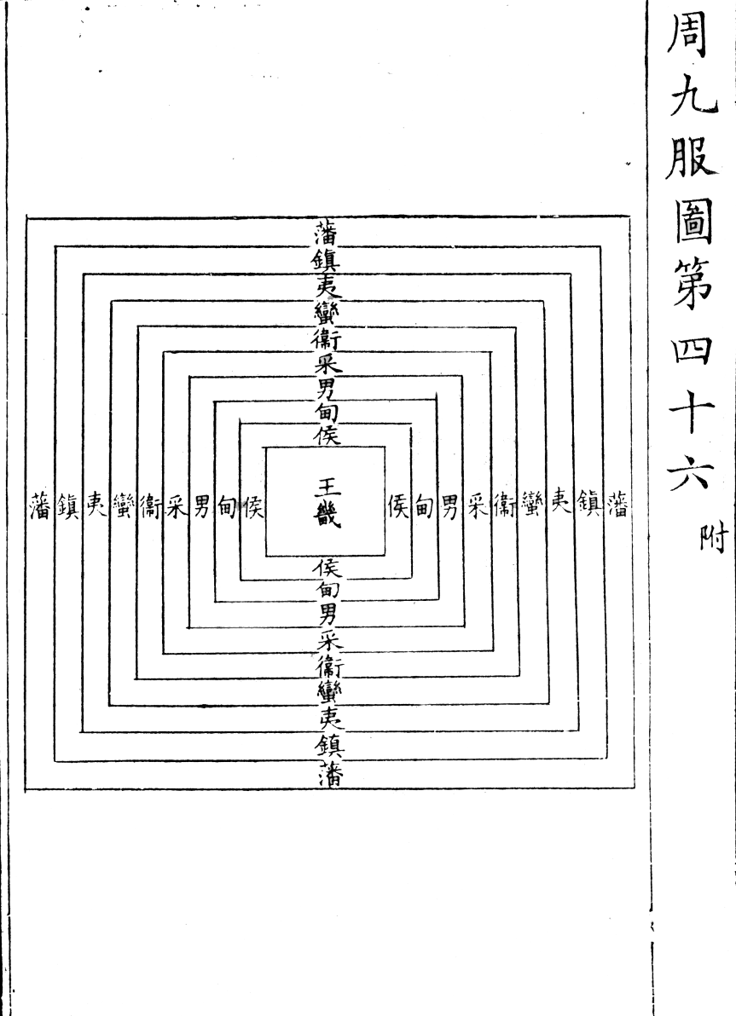
WESTERN ZHOU (ca. 1027-771 BCE) Political Order
Feudalism (OED definition): “the system of polity… based on the relation of superior and vassal arising out of the holding of lands in feud.” Feud implies property granted through patronage.
*Please note that European feudalism and Chinese feudalism were not entirely the same (and Japanese feudalism was different still!)

Slide 7
“Mandate of Heaven” (tianming 天命)
The Confucian notion that Heaven has granted a ruler’s authority to govern, and that this right may be withdrawn if that ruler proves to be incompetent or cruel.
“Son of Heaven” (tianzi 天子): title for the supreme leader of the Zhou ruling house, beginning in the early Zhou period.
“Central States” (zhongguo 中國): a loose term for the separate kingdoms on the North China plain. All kingdoms and people outside of this area were considered peripheral to the “civilized” core. From this ancient term we get the modern name for China .

